Slide 1

Chapter 1
Teachers Discovering Computers
Integrating Educational Technology into the Curriculum

Slide 2
Chapter Objectives
Define curriculum-specific learning
Explain the difference between computer, information, and integration literacy
Explain why it is necessary to change instructional strategies from traditional to new learning environments
Describe the evolution of computers and digital media
Differentiate among the various categories of computers
Explain why computer technology and digital media are important for education

Slide 3
Chapter Objectives
Describe the National Educational Technology Standards for Teachers (NETS-T) and Students (NETS-S)
Explain why 21st century skills need to be incorporated in K-12 curriculum
Describe the characteristics of today’s digital students
Describe six categories of what today’s students need to know
Provide examples of how computers are changing the way people teach and learn
Describe why it is so important for every teacher to have a current ePortfolio

Slide 4
Curriculum-Specific Learning
Three ways you can use the knowledge you acquired
  For your own professional development,
  For using technology as a productivity tool in your classroom,
  For extensively integrating technology, mobile devices, and digital media into your
    instructional strategies
    Lessons
    student-based projects
    student assessments
To improve student learning

Slide 5
Curriculum-Specific Learning (cont)
Traditional Learning Environments | New Learning Environments Teacher-
Teacher- centered instruction | Student- centered learning
Single- sense stimulation | Multisensory stimulation
Single- path progression | Multipath progression
Single media | Multimedia
Isolated work | Collaborative work
Information delivery | Information exchange
Passive learning | Active/ exploratory/ inquiry- based learning
Factual, knowledge- based learning | Critical thinking and informed decision making
Reactive response | Proactive/ planned action
Isolated, artificial context | Authentic, real- world context

Slide 6
Computer, Information, and Integration Literacy
Computer literacy
  Knowledge and understanding of computers and their uses
Information literacy
  Knowing how to find, analyze, and communicate information
Integration literacy
  The ability to use computers, mobile devices, digital media, and other technologies combined with a variety of teaching and learning strategies to enhance students’ learning

Slide 7
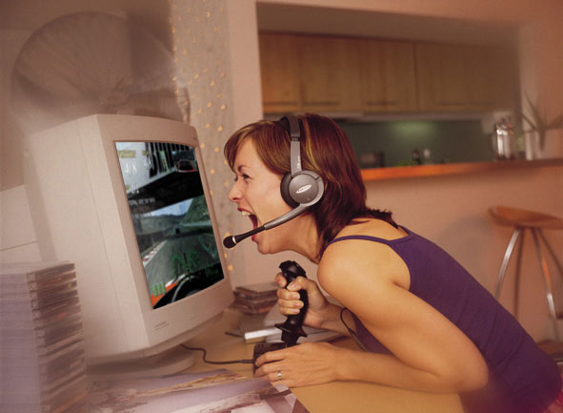
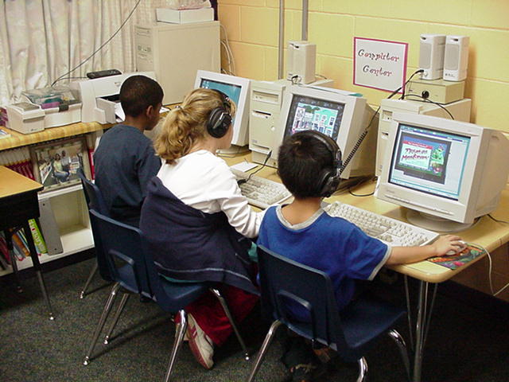
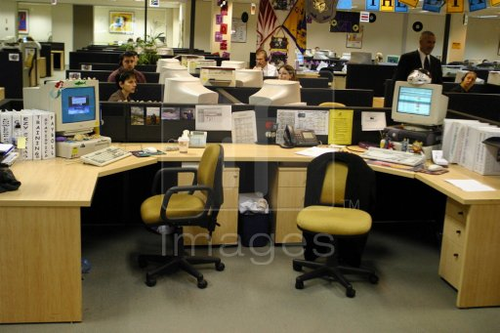

Computer, Information, and Integration Literacy
Computer technology, digital media, and mobile devices are present in every aspect of daily living
  in the workplace
  at home
  in the classroom
  ued for entertainment

Slide 8
What Is a Computer and What Does It Do?
An electronic device, operating under the control of instructions stored in its memory, that can accept data, process the data according to specified rules, produce results, and store the results for future use
A computer is a computational device

Slide 9
What Is a Computer and What Does It Do?
Data - collection of unorganized facts
Information - data that is organized, meaningful, and useful
Input - data entered into a computer
Output - processed results from a computer

Slide 10
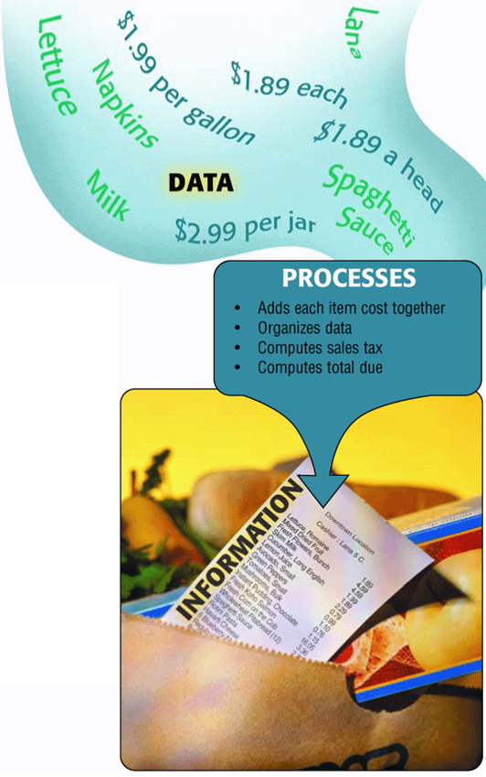
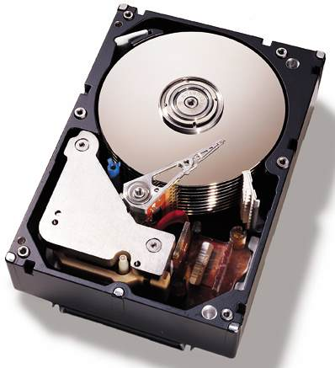
What Is a Computer and What Does It Do?
The four primary operations of a computer are:
  Input Data
  Process
  Output Information
  Store Data
Known as the information processing cycle.

Slide 11
What Is a Computer and What Does It Do?
A user inputs data into a computer, and the computer processes it.
When data is processed, into a meaningful or useful form, it becomes information.
Data that is not meaningful or useful after process is know by the term Garbage In Grabage Out (GIGO).

Slide 12
What Is a Computer and What Does It Do?
Storage – holding data and information for future use
Information processing cycle – the cycle of input, process, output, and storage
Hardware – the electronic and mechanical equipment that makes up the computer
Software – a series of instructions that tells the hardware how to perform tasks

Slide 13
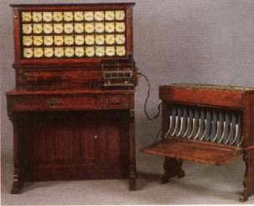
The Evolution of Computers and Digital Media
Before 1946: Precomputers and Early
Computers

Slide 14
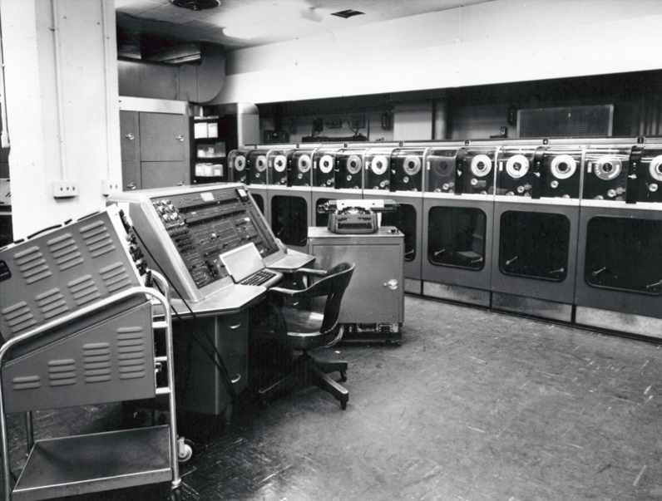
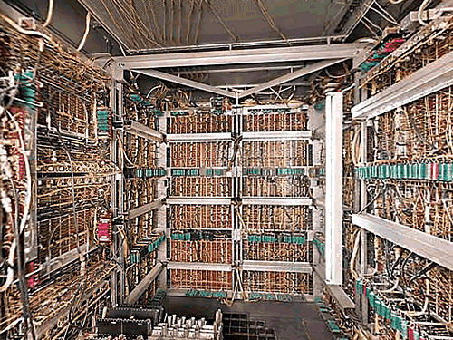
The Evolution of Computers and Digital Media
Approx. 1946-1957: First-Generation
Computers
  Large room sized
  Used paper puch cards and tapes
  UNIVAC was the first mass produced computer.

Slide 15
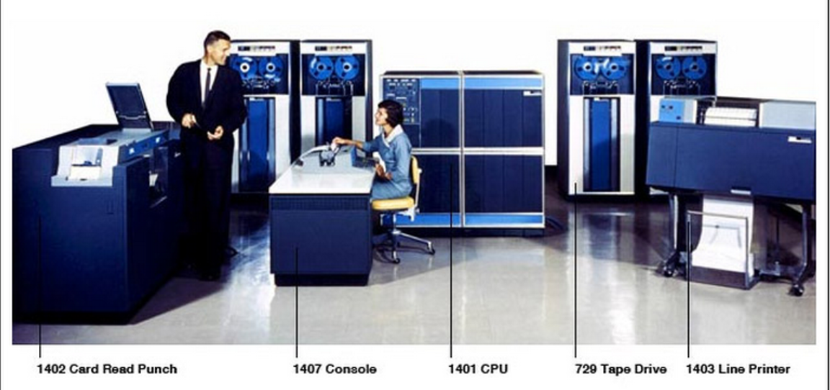
The Evolution of Computers and Digital Media
1958-1963: Second-Generation Computers – IBM 1401

Slide 16
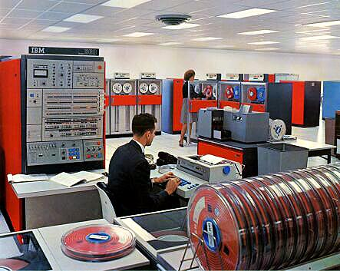
The Evolution of Computers and Digital Media
1964-1970: Third-Generation Computers – IBM/System 360 IC’s

Slide 17
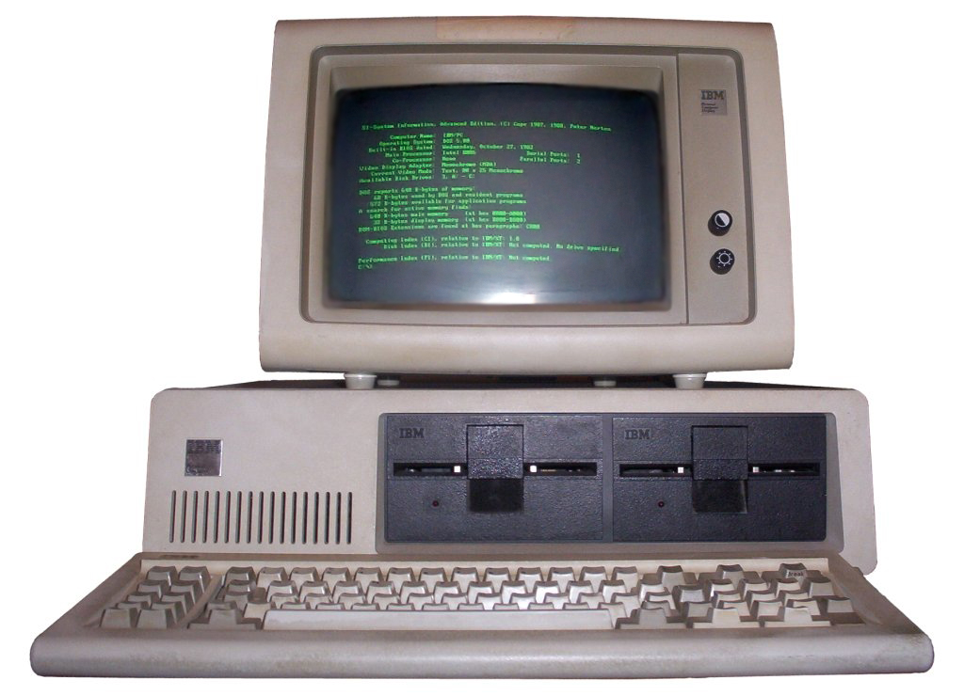

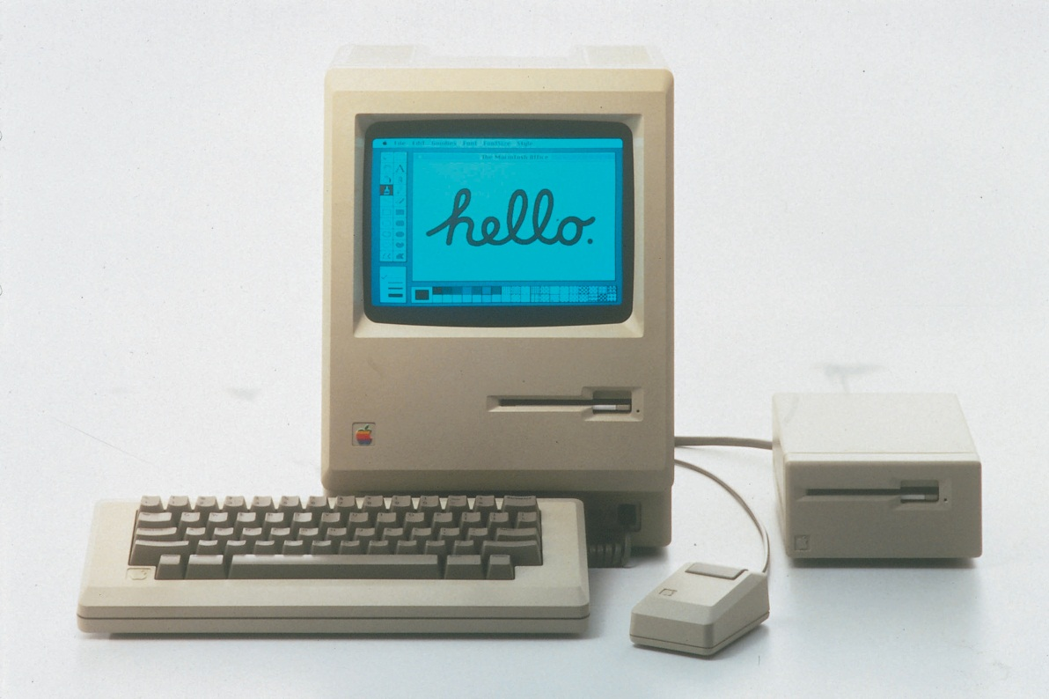
The Evolution of Computers and Digital Media
Approx. 1971-Present: Fourth-Generation Computers
Introduction of the CPU
Apple Macintosh
IBM 5150

Slide 18
The Evolution of Computers and Digital Media
The first decade of the 21st century was known as the age of convergence.
Convergence is merging the various forms of communications ( the telephone, television, and computers) into effective, interactive, mobile devices.
This age of convergence will continue to evolve in new, exciting ways
Today’s personal computer and mobile device architectures take advantage of a computer’s individual power, digital media capabilities, and the ability to be interconnected with others in networked environments, also known as social networking.
As a result, multimedia technology systems have become increasingly more powerful and better able to handle information rich in visual and aural content.

Slide 19
The Evolution of Computers and Digital Media
The goal of multimedia computing and communications is to assist individuals in organizing and managing vast amounts of information in various types of media
Digital media – technologies that allow users to create new forms of interaction, expression, communication, and entertainment in a digital format

Slide 20
Categories of Computers
Personal computers
Mobile computers and mobile devices
Game consoles
Servers, supercomputers, and embedded computers

Slide 21
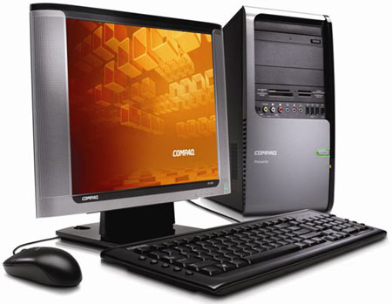
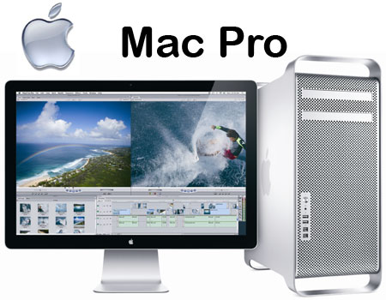
Personal Computers
Personal computers also called desktop computers are designed so the system unit, input devices, output devices, and any other devices fit entirely on a desk.
A personal computer has the capability to perform input, processing, output, and storage activities.
Notes:
Figure 1-7

Slide 22
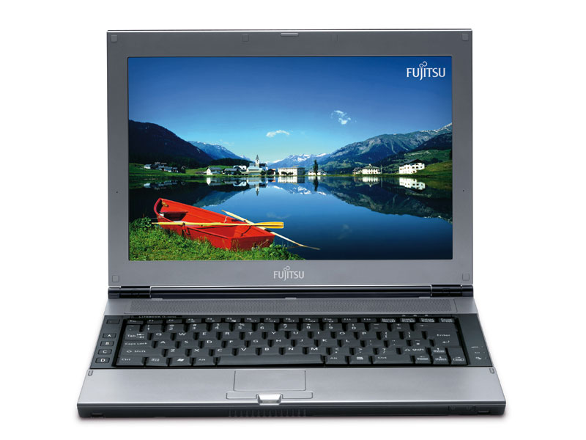
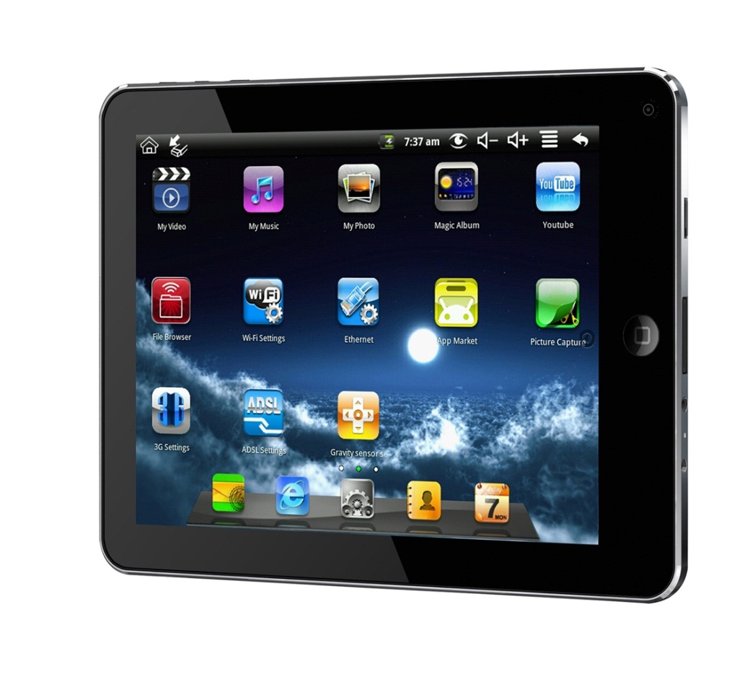
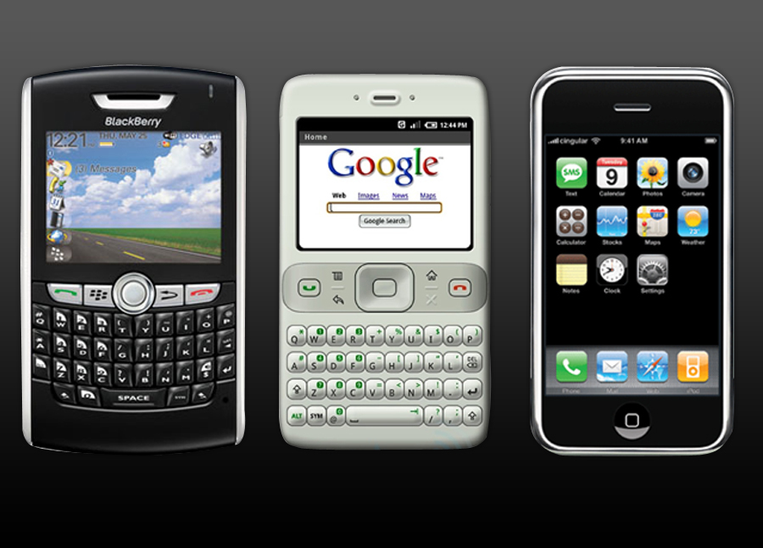
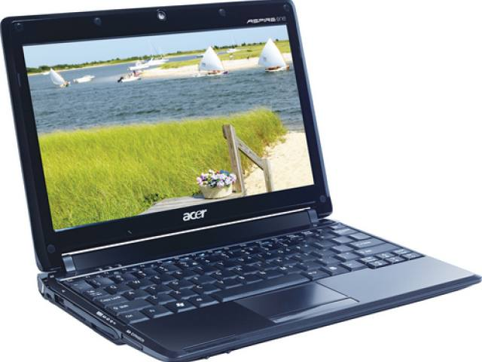
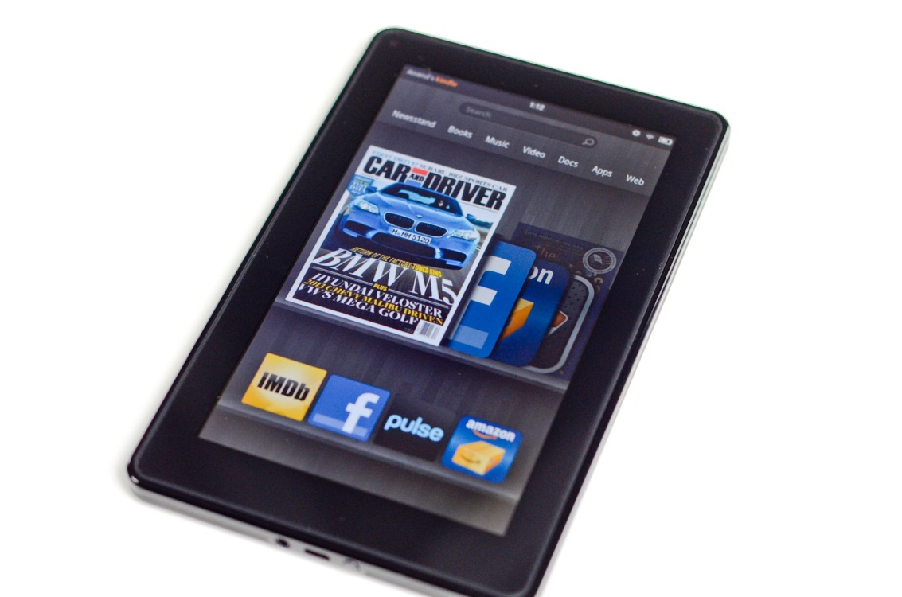
Mobile Computers and Mobile Devices
Mobile Computers
  Notebook
  computer
  Tablet computer
  Netbook
Mobile Devices
  Smartphone
  E-book reader

Slide 23
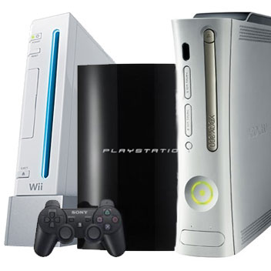
Game Consoles
Computing device designed for single player or multiplayer video games
Controller is the input device on standard game consoles
Television is the output device
Hard Disks, optical discs, and memory cards are used for storage

Slide 24
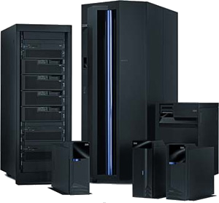
Midrange Servers
A midrange server (sometimes called a minicomputer) is a medium-sized computer used to host programs and data for a small network.
One trend involving midrange servers, as well as the mainframe computers, is virtualization.

Slide 25
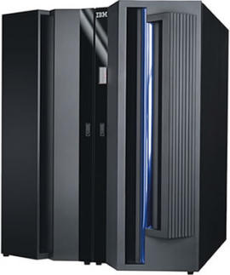
Mainframe Computers
A mainframe computer is a powerful computer used in many large organizations that need to manage large amounts of centralized data.

Slide 26
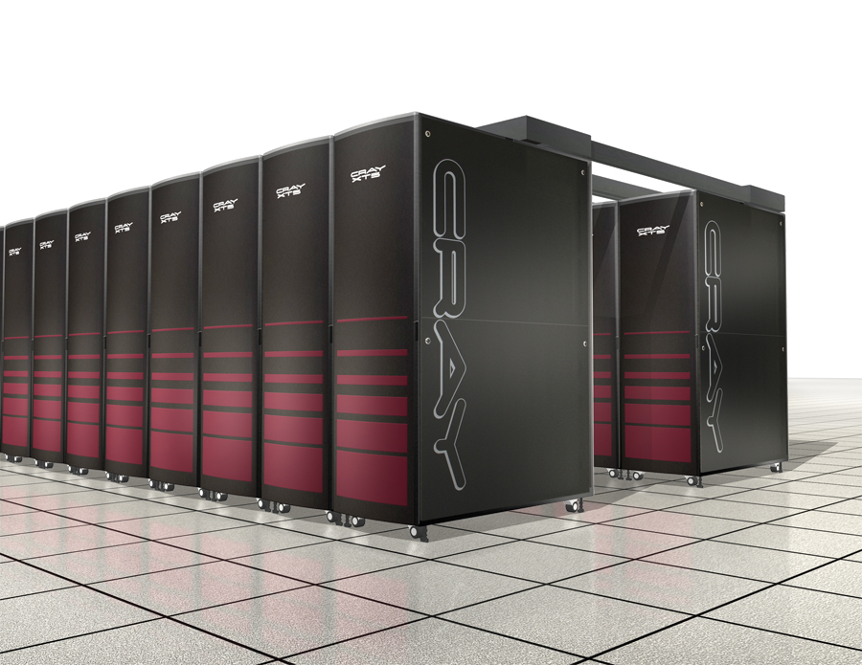
Supercomputers
Supercomputers are the most powerful and most expensive type of computer available.
To reduce the cost, supercomputers are often built by connecting hundreds of smaller and less expensive
computers into a supercomputing cluster that acts as a single supercomputer.

Slide 27
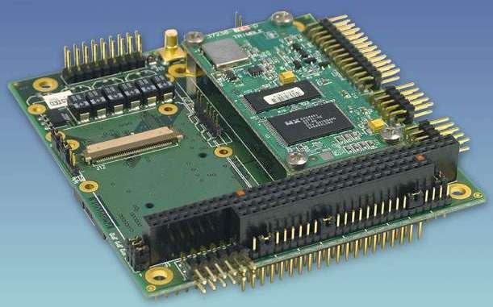
Embedded Computers
An embedded computer is a tiny computer embedded into a product designed to perform specific tasks or functions for that product.
Used in appliances.

Slide 28
Why Use Computer Technology in Education?
Technology and digital media are everywhere
Technology can support learning
Computers support communications beyond classroom walls
Support of national and international organizations

Slide 29
International Society for Technology in Education ( ISTE),
On of the leading nonprofit group that promotes the use of technology to support and improve teaching and learning.
ISTE has been instrumental in developing the National Educational Technology Standards ( NETS) for the National Council for Accreditation for Teacher Education ( NCATE).
NCATE is the official body for accrediting teacher education programs.
ISTE has developed standards for K- 12 teachers, school administrators, and students.

Slide 30
International Society for Technology in Education ( ISTE),
Web address for ISTE http://www.iste.org/welcome.aspx.
Web address for NCATE http://www.ncate.org/

Slide 31
The World Is Flat
In his books, The World Is Flat and Hot, Flat, and Crowded, Thomas Friedman describes how “ lightning- swift changes in technology and communications put people all over the globe in touch with each other as never before
Friedman and others stress that many young people are not prepared to be successful in a global economy, which in turn is impacting how America competes on the world stage.
The web address for the Flat Classroom Projects is http://www.flatclassroomproject.org/

Slide 32
21st Century Skills
The Partnership for 21st Century Skills is a national organization that focuses on infusing 21st century skills into education
The partnership’s goal is to ensure that students who graduate from our schools have the skills needed to be effective workers, citizens, and leaders in the new global economy.
The web address for the partnership is http://www.p21.org/

Slide 33
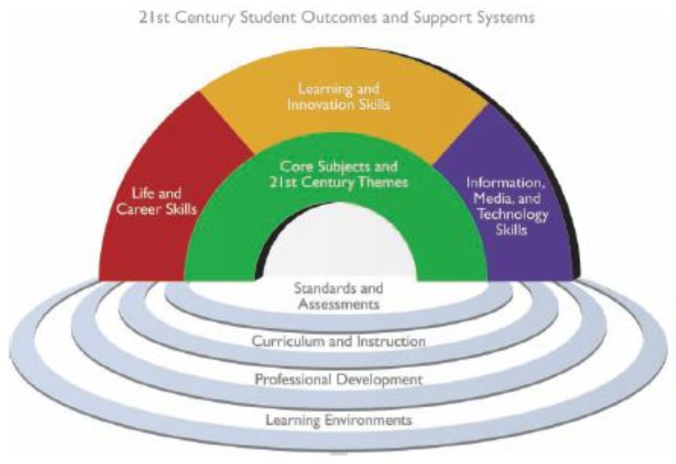
21st Century Skills

Slide 34
Computing in the Digital Age
Digital Students: Who are they and how do they learn?
  Digital generations - students use different technologies to communicate and to access information from multiple resources
  Digital students (digital kids)
    Hypercommunicators
    Multitaskers
    Goal oriented

Slide 35
Computing in the Digital Age
Creativity and Innovation - Students demonstrate creative thinking, construct knowledge, and develop innovative products and processes using technology.
  apply existing knowledge to generate new ideas, products, or processes.
  create original works as a means of personal or group expression.
  use models and simulations to explore complex systems and issues.
  identify trends and forecast possibilities
Original information found on www.iste.org website

Slide 36
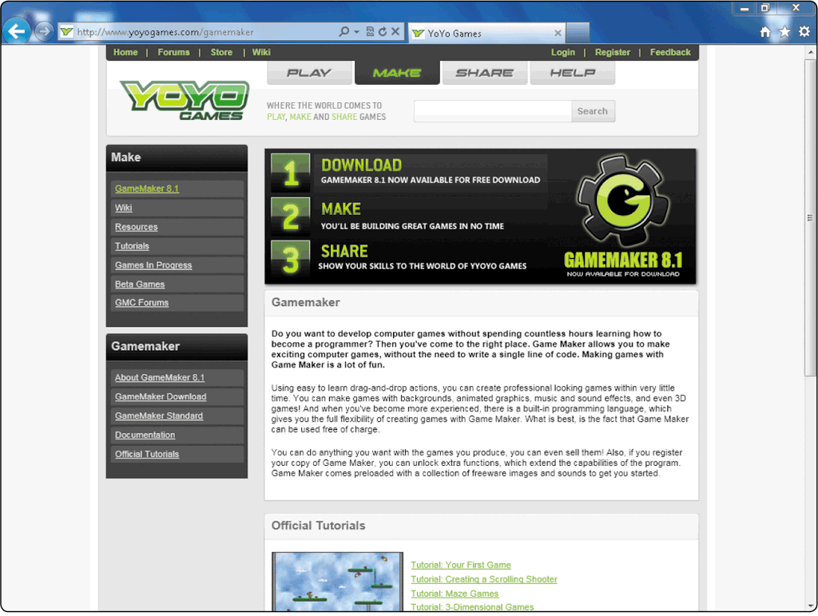
Computing in the Digital Age
Gamemaker is an example of a software program that allows students to create video games while fostering opportunities for creativity and innovation

Slide 37
Computing in the Digital Age
Communication and Collaboration - Students use digital media and environments to communicate and work collaboratively, including at a distance, to support individual learning and contribute to the learning of others. Students:
  interact, collaborate, and publish with peers, experts, or others employing a variety of digital environments and media.
  communicate information and ideas effectively to multiple audiences using a variety of media and formats.
  develop cultural understanding and global awareness by engaging with learners of other cultures.
  contribute to project teams to produce original works or solve problems.
Original information found on http://www.iste.org/welcome.aspx website

Slide 38
Computing in the Digital Age
Research and Information Fluency - Information fluency is when a person has mastered the ability to analyze and evaluate information
  Students apply digital tools to gather, evaluate, and use information. Students:
    plan strategies to guide inquiry.
    locate, organize, analyze, evaluate, synthesize, and ethically use information from a variety of sources and media.
    evaluate and select information sources and digital tools based on the appropriateness to specific tasks.
    process data and report results.
Original information found on http://www.iste.org/welcome.aspx website

Slide 39
Computing in the Digital Age
Critical Thinking, Problem Solving, and Decision Making - Students use critical thinking skills to plan and conduct research, manage projects, solve problems, and make informed decisions using appropriate digital tools and resources. Students:
  identify and define authentic problems and significant questions for investigation.
  plan and manage activities to develop a solution or complete a project.
  collect and analyze data to identify solutions and/ or make informed decisions.
  use multiple processes and diverse perspectives to explore alternative solutions.
Original information found on http://www.iste.org/welcome.aspx website

Slide 40
Computing in the Digital Age
Digital Citizenship - students understand human, cultural, and societal issues related to technology and practice legal and ethical behavior. Students:
  advocate and practice safe, legal, and responsible use of information and technology.
  exhibit a positive attitude toward using technology that supports collaboration, learning, and productivity.
  demonstrate personal responsibility for lifelong learning. d. exhibit leadership for digital citizenship.
Original information found on http://www.iste.org/welcome.aspx website

Slide 41
Computing in the Digital Age
Technology Operations and Conceptss - Students demonstrate a sound understanding of technology concepts, systems, and operations. Students:
  understand and use technology systems.
  select and use applications effectively and productively.
  troubleshoot systems and applications.
  transfer current knowledge to learning of new technologies.
Original information found on http://www.iste.org/welcome.aspx website

Slide 42
Computing in the Digital Age
ARCS motivational model
Developed in 1983 and applicable to learning in the digital age

Slide 43
Computing in the Digital Age
Attention - Lessons are designed to gain students’ attention using alternative techniques, such as a story, sensory stimuli, thought- provoking questions, and variability in exercises, and using digital media.
Relevance - Students see relevance in the lesson, which, in turn, leads to increased learning. The lesson must be relevant not only to the learner, but also to previously taught lessons.

Slide 44
Computing in the Digital Age
Challenge/Confidence - Students are challenged to achieve, and they gain confidence as they meet the challenge. Students need to feel that if they put in a good faith effort, they are capable of achieving the objectives. The challenge should properly match the students’ abilities.
Satisfaction/Success - Students gain success in achieving their objective, which promotes self- satisfaction from the learning experience. The most powerful reward is that the students find that the learning experience is relevant and useful to their own world or the one they aspire to live and work in.

Slide 45
Creating a Professional Teaching Portfolio
One tool that will set you apart from the crowd
Highlight your instructional credentials and provide a sampling of your work
  Detailing your accomplishments
  Showcasing your development of content-specific standards-based lessons
Keep up to date

Slide 46
What Is a Professional Teaching Portfolio?
A professional teaching portfolio, also known as an ePortfolio, e-Portfolio, or eFolio, is a collection of evidence to document your development and growth in the teaching profession
  Includes materials and artifacts to document or provide evidence of your education, background, philosophy, teaching strategies, experience in teaching, lesson plans, your personal achievements, and more
The emergence of virtual learning environments (VLEs) in K-12 schools and universities has led to an increased rationale for ePortfolios

Slide 47
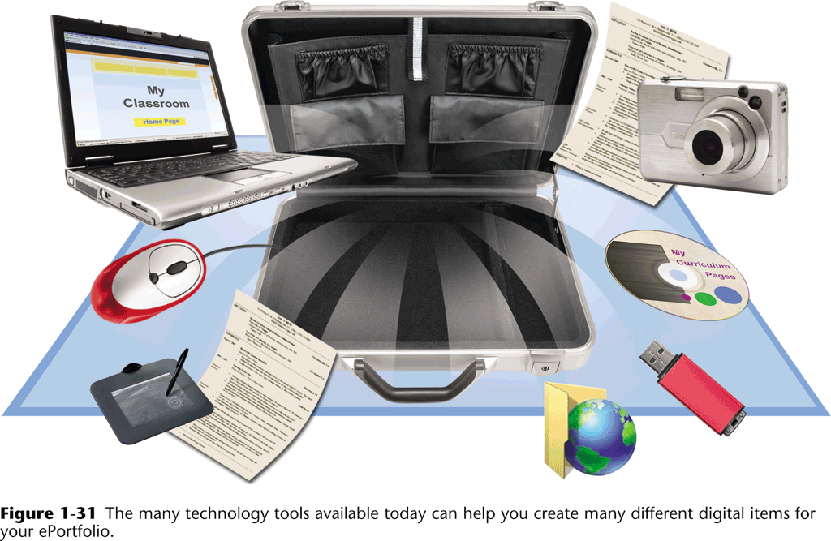
What Is a Professional Teaching Portfolio?
You probably will use the materials in your ePortfolio for multiple purposes and for different audiences, so it is very important that your collection of digital evidence be current and accurately reflect you

Slide 48
What Should Be Included in Your ePortfolio?
Philosophy of education
Resume
Reflective essays
Presentations
Research papers
Images
Videos
Projects
Reports
Lesson samples
Letters from students, instructors, and feedback from others

Slide 49
Where Should I Store My ePortfolio
Many are maintained within a university’s VLE
LiveText is a flexible management system that provides institutions of higher learning with advanced and user-friendly Web-based tools for developing, assessing, and measuring student learning and more
Create more than one backup of your ePortfolio by saving your materials to another medium, such as your hard drive or a flash drive or both
  Keep backups in different locations

Slide 50
Impact of Smartphones, Tablet Computers, and Apps on Education
Many experts are predicting that in the near future every student in the United States and the majority of students in many other countries will be using an array of mobile devices
Your students’ tablet computers will be loaded with digital textbooks, interactive textbook apps, social media apps, and an array of inexpensive curriculum- and grade-specific education apps and games
To be competitive in our changing flattening world, our future leaders and workers must be prepared to utilize current and emerging technologies

Slide 51
The Digital Divide
The Digital Divide, or the digital split, is a social issue referring to the differing amount of information between those who have access to the Internet (specially broadband access) and those who do not have access.
Broadly speaking, the difference is not necessarily determined by the access to the Internet, but by access to ICT (Information and Communications Technologies) and to Media that the different segments of society can use.
With regards to the Internet, the access is only one aspect, other factors such as the quality of connection and related services should be considered.
Today the most discussed issue is the availability of the access at an affordable cost.

Slide 52
The Digital Divide
The disadvantage can take such forms as
  lower-performance computers
  lower-quality or high price connections (i.e. narrowband or dialup connection)
  difficulty of obtaining technical assistance
  lower access to subscription-based contents.

Slide 53
Chapter Summary
Define curriculum-specific learning
Explain the difference between computer, information, and integration literacy
Explain why it is necessary to change instructional strategies from traditional to new learning environments
Describe the evolution of computers and digital media
Differentiate among the various categories of computers
Explain why computer technology and digital media are important for education

Slide 54
Chapter Summary
Describe the National Educational Technology Standards for Teachers (NETS-T) and Students (NETS-S)
Explain why 21st century skills need to be incorporated in K-12 curriculum
Describe the characteristics of today’s digital students
Describe six categories of what today’s students need to know
Provide examples of how computers are changing the way people teach and learn
Describe why it is so important for every teacher to have a current ePortfolio

